Slide 1

Fall Seminar 2025 Pre IB Years
International Baccalaureate Program
Palm Harbor University High School

Slide 2
PSAT Why Take the PSAT/NMSQT?
See your progress over every PSAT you have taken and track your improvement.
CAREERS: Explore careers that you're passionate about on BigFuture by taking the Career Quiz and learning how your test performance aligns to 1,000 occupations with our career readiness indicator.
COLLEGES: Search over 3,000 college profiles on BigFuture to discover which colleges and programs are right for you. Filter by location, major, and more.
SCHOLARSHIPS: Use your scores to access scholarships from BigFuture Scholarships, and thousands of others.
SAT PRACTICE: Send your scores to Khan Academy® for a free, personalized SAT practice plan based on your test results.
AP POTENTIAL: See which courses are offered at your school and which classes match a future major that may interest you.
Your SCORE REPORT will give details on each question and answer. Show how you did, give the right and wrong answers and why.
The SCORE REPORT will also provide insight into strengths and weaknesses.

Slide 3
Preparing for the NMSQT National Merit Scholarship Qualifying Test: Junior Year
PSAT is Taken in October every year
Qualifies you for scholarships and recognition for college applications in JUNIOR year
Thursday, October 16th

Slide 4
BRIGHT FUTURE SCHOLARSHIPS
FLORIDA ACADEMIC SCHOLARSHIP
FLORIDA MEDIALLION SCHOLARSHIP
3.5 GPA
29 ACT
1330 SAT
100 Hours
3.0 GPA
24 ACT
1190 SAT
75 hours

Slide 5
IB Diploma
Bright Futures Academic Scholarship
Notes:
Shepherd-Thompson

Slide 6
Start Researching Colleges and Careers Now
Visit local colleges
Go online to check out colleges in subjects you’re interested in and locations you’d love
Go to the virtual and in person College Fairs in the community
Talk to teachers, family friends, mentors about their careers and colleges they attended
Notes:
Shepherd-Thompson

Slide 7
College Research - Where do They want to go?
Xello!
Florida Shines - www.floridashines.org
Big Future Collegeboard - www.bigfuture.collegeboard.org
eCampus Tours - ecampustours.com
Admittedly - admitted.ly
Cappex - cappex.com
Chegg - chegg.com
College Raptor- collegeraptor.com
Is this college a good fit for me?
Do they have my major?
SAT?
ACT?
GPA?
LOCATION?
Is the price tag realistic?
What is their 4 year graduation rate?
What is their avg freshman retention rate?
Are there options for study abroad?
Are their students employed upon graduation?

Slide 8
SAT – collegeboard.org
2 sections
Scoring - range 200-800
Fee Waiver
Superscoring
Critical Reading & Writing
Math
800 max
total is 1600

Slide 9
ACT – act.org
3 or 4 sections
Scoring - Range
1-36
Each section gets scored
Composite = all sections averaged together
Super scoring
Fee Waiver
English, Math, and Reading. Science is now OPTIONAL

Slide 10
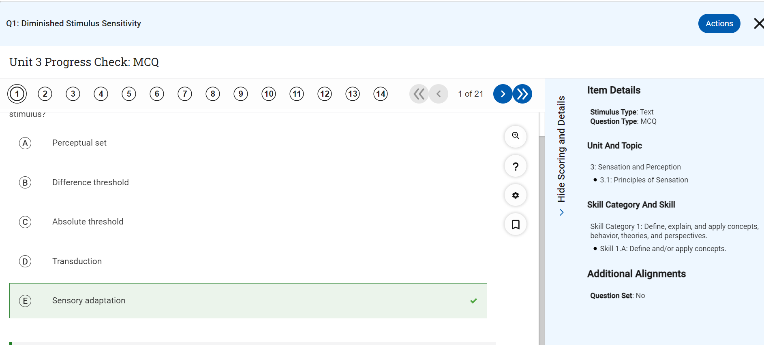
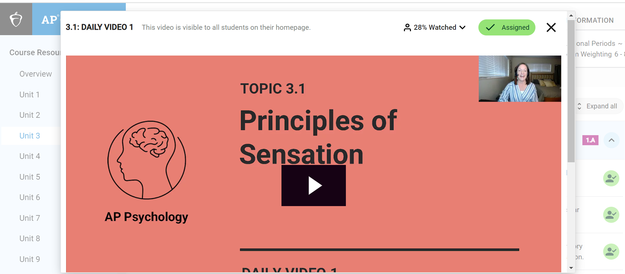
Advanced Placement Support
AP Classroom
Log in with College Board Account
Daily Videos
Unit Progress Checks
Notes:
Dindial-Thompson

Slide 11
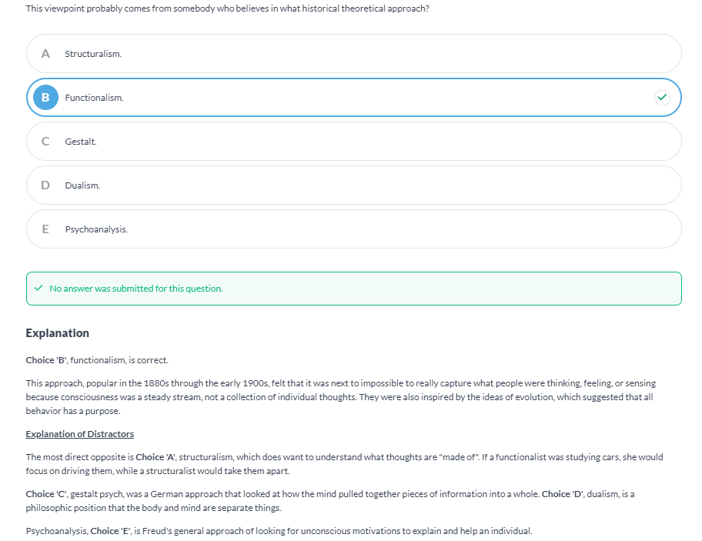
Advanced Placement Support
AlbertIO
Log in via Clever
Organized by unit
Teacher assigned work or student independent practice
Explanation of correct answers
Explanation of distractors
Notes:
Dindial-Thompson

Slide 12
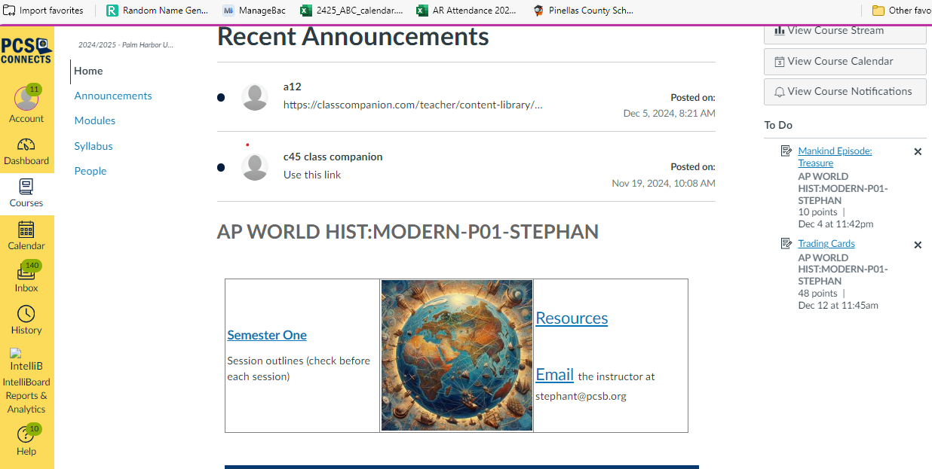
Advanced Placement Support
Canvas
Parent log in or student log in.
Homework and instructions for assignments are posted
Notes:
Dindial-Thompson

Slide 13
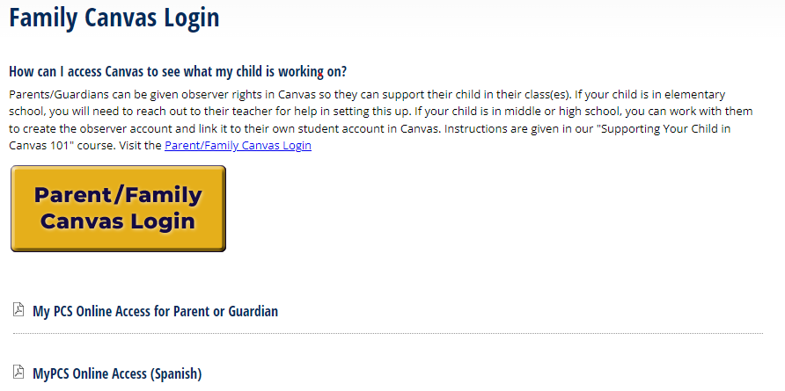
Advanced Placement Support
Canvas
Parent log in or student log in.
Homework and instructions for assignments are posted
Notes:
Dindial-Thompson

Slide 14
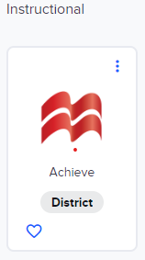
Advanced Placement Support
Canvas
Parent log in or student log in.
Homework and instructions for assignments are posted
Notes:
Dindial-Thompson

Slide 15
How we approach Teaching & Learning in IB
Thinking Skills
Social Skills
Self-Management Skills
Research Skills
Communication Skills
Inquiry
Developed in Local & Global Contexts
Designed to remove Barriers
Focus on Teamwork & Collaboration
Conceptual Understanding
Informed by Assessment
Notes:
Striblen

Slide 16
How can you support the IB Approach to Teaching and Learning?
Where & How does your student study?
Do they plan breaks?
Do they change the type of homework/studying every 45 minutes to switch their brain’s gears?
Location matters: think noise, brain association, distractions
How do they organize their time?
Planners
Making time for joy
Focusing on A day A night, B day B night, C day C night
Self-Advocacy
Ask your teachers for help; they are there to support you, but they need to when you need their help, including when you’re just struggling with life stuff!
Attend available tutoring times
Notes:
Striblen

Slide 17

The IB Core is gradually introduced to our Pre-IB students through the common planning of their teachers and staff and through the skills taught in IB Approaches to Learning
CAS
TOK
EE
These are integrated in developing ourselves with the attributes of the IB Learner Profile
Notes:
Tancrell

Slide 18
The IB Core – CAS Students WILL earn their Bright Futures service requirements in CAS during their Junior and Senior years
Creativity-Activity-Service
Divided among the three areas
Planned (approved)
Activities carried out continuously over time
Documented; evidenced
Signed off by an objective adult supervisor
Required interviews and reflection
Final review by IB CAS Coordinator
Notes:
Tancrell

Slide 19
Start Preparing for CAS… How is your student getting involved?
Leadership, growth, impact
Quality
Number of “things”
Quantity
Clubs
Sports
Service
Leadership
Notes:
Tancrell

Slide 20
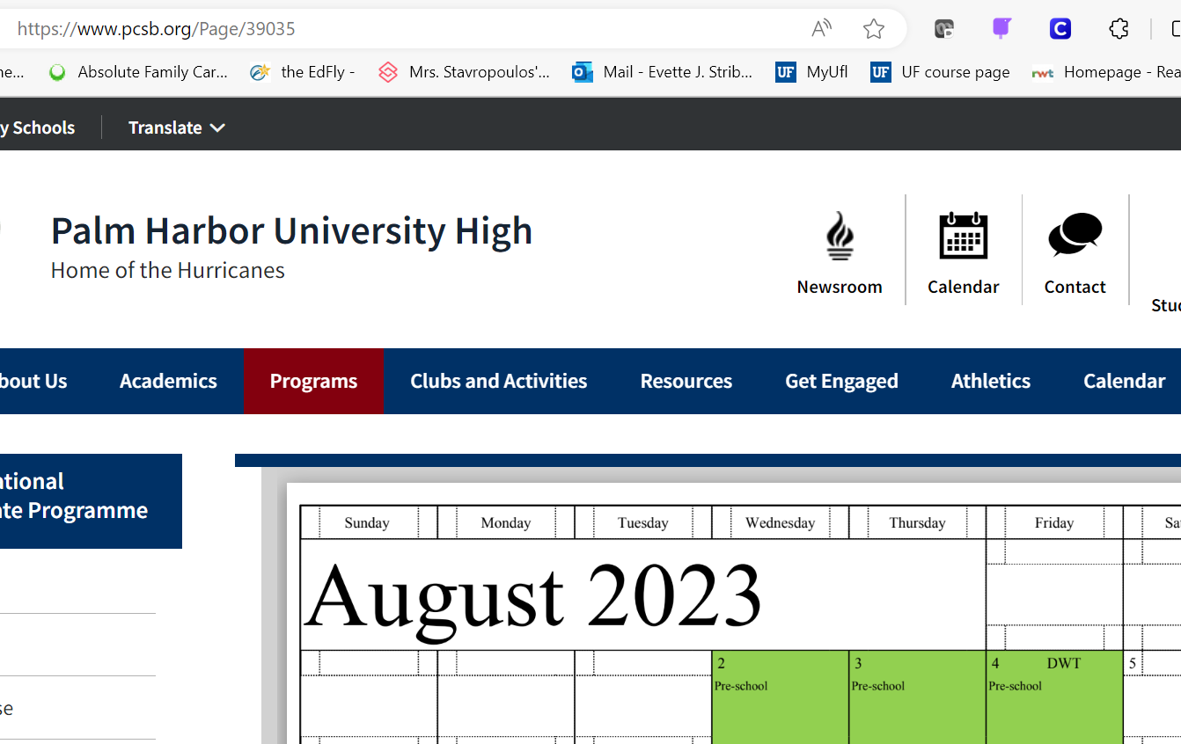
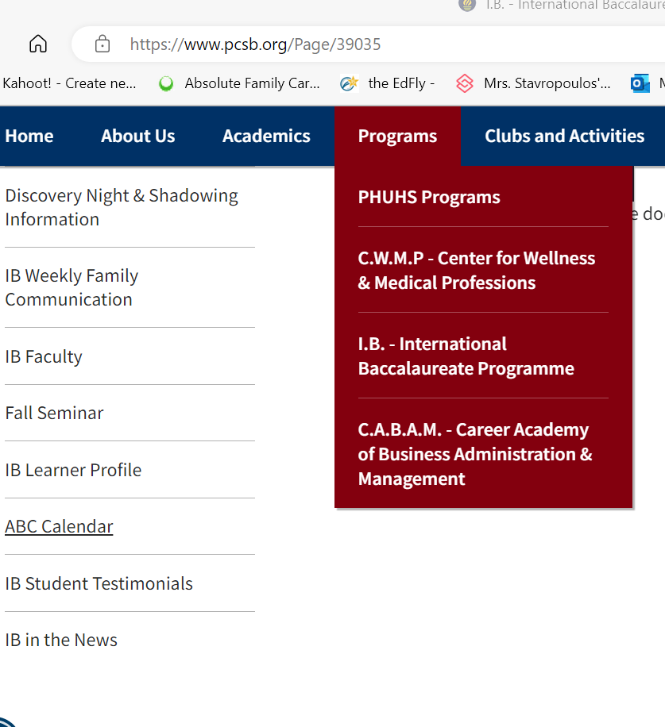
Important Dates: -Check Website ABC Calendar -Juniors & Seniors get a packet with all of IB deadlines for BOTH Jr. & Sr. years
Notes:
Striblen

Slide 21
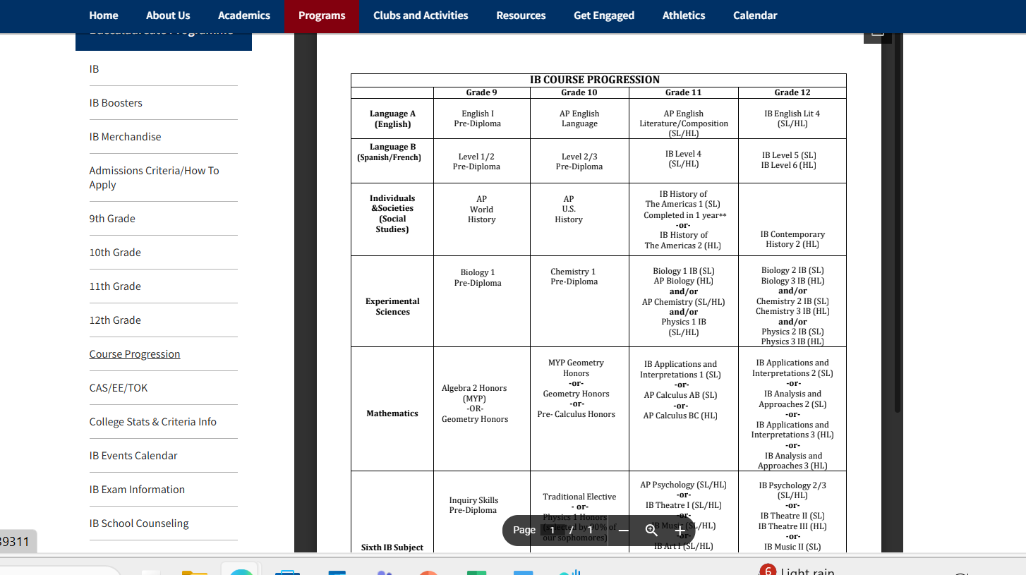
IB Course Progression (see website)

Slide 22
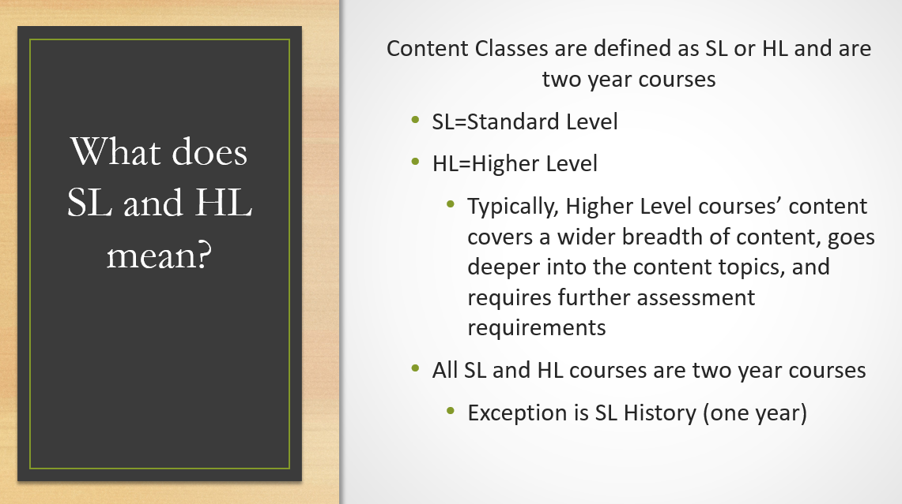
Planning for next year’s courses
Or Global Politics

Slide 23

How many HL and SL classes do I take?
IB requires
3 HL and 3 SL courses

Slide 24
Students will sign up in January to visit classes after Mrs. ST meets with them to go over course selections
Sign up is in Diploma Support
Students can visit up to 4 classes
Visits take place during their Diploma Support when we return from break in January
If visiting SL History, must also visit HL History
New this year, students may be able to take SL History OR SL Global Politics --dependent on student interest and master schedule

Slide 25

How do I earn my IB Diploma?
Each course is out of 7 points (determined by IB exams)
earn 12 points in HL Courses
earn 9 points in SL Courses
earn 24 points overall
Complete CAS (learning outcomes and project)
Complete Extended Essay
Complete TOK essay and exhibition

Slide 26
All Juniors and Seniors have TWO Diploma Support Classes

Slide 27
Extended Essay
Theory of Knowledge
CAS
Group 1
Studies in Language and Literature
Language A Literature
HL/SL
Group 2
Language Acquisition
French B HL/SL
Spanish B HL/SL
Group 3
Individuals & Societies
History HL/SL***
Psychology HL/SL*
Group 4
Experimental Sciences
Biology HL/SL
Chemistry HL/SL
Physics HL/SL
Sports Exercise Science SL**
Group 5
Mathematics
Applications & Interpretations HL/SL
Analysis & Approaches HL/SL
Group 6
Arts & Electives
Film SL**
Music HL/SL
Theatre Arts HL/SL
Visual Arts HL/SL
Psychology HL/SL
Sports Exercise Science SL**
There are 6 groups students take classes from in IB
*Course considered a group 6 elective
**Only offered in Senior year as a 1 year course for students who took SL History
***SL is a one year course for this subject

Slide 28
IB, GPA, and College Course Credits
Students typically earn up to 45 college credits (Florida University System)
All Junior and Senior courses are IB courses—college level
All Freshman and Sophomore courses are Honors or AP level
Students may take Dual Enrollment and additional Honors, AP, etc. courses during the summer
Students may participate in internships during the summer after their Junior year
The majority of Universities accept IB credits in some way—see our website to learn more

Slide 29
IB | AP | DE & Early College | Benefits
Full Course Meal | Buffet | Home cooked meal | AP Pick and choose College Level Course with GPA advantage Nationally recognized Teachers trained by College Board
Curriculum set, monitored, & assessed by The International Baccalaureate Organization (IBO) | Curriculum set, monitored, & assessed by College Board | Curriculum set by local Junior College | IB Internationally recognized Interdisciplinary instruction between teacher teams/subjects AP/IB teacher planning through District and site based teacher teams Includes research opportunities highly recognized by colleges through internal assessments and extended essay in the Junior and Senior years Teachers trained by IBO, most also trained by College Board Students are in ALL Honors, AP, and IB level courses through 9-12 impacting their knowledge built and GPA
IB Programme Includes AP courses in progression and ability to take DE during summer | Individual Courses | Individual Courses
Opportunity to earn college credit for IB courses based on exam (1.0 GPA weight based on grade), Honors credit for Pre-IB (.5 GPA weight based on grade) | Opportunity to earn college credit (based on exam) per course and 1.0 GPA weight (based on grade) | Opportunity to earn college credit based on grade and 1.0 GPA weight | DE College Credit and GPA advantage College Credits & GPA advantage College Transcript Begun EE 1. Earn AA Degree

Slide 30

QUESTIONS
Notes:
Shepherd-Thompson

